Slide 1

CONSUMER GOODS AD-HOC INSIGHTS
ATLIQ HARDWARES
R ANAND BHASKAR

Slide 2
Project Description
Our Company
Atliq Hardwares - One of the leading computer hardware producers in India.
Background
The management noticed that they do not get enough insights to make quick and smart data-informed decisions.
Problem
There are 10 ad-hoc requests for which the company needs insights.
Approach
Run a SQL query to answer these requests. Convert it into visualizations and present the Insights to the top level management.

Slide 3
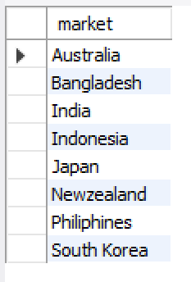
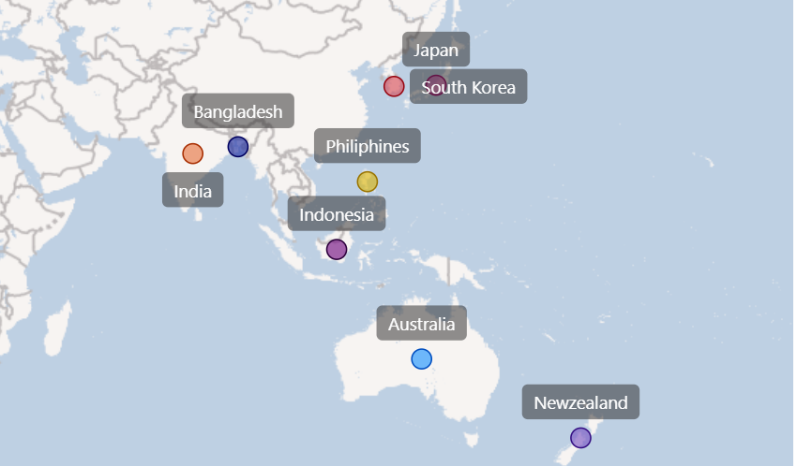
Request 1 : Provide the list of markets in which customer "Atliq Exclusive" operates its business in the APAC region.

Slide 4
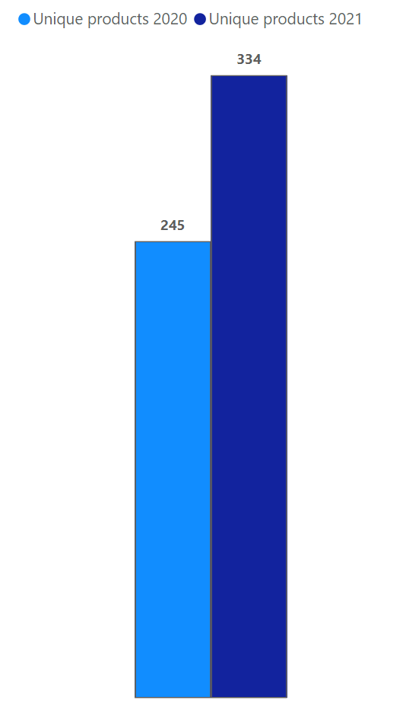

Request 2 : What is the percentage of unique product increase in 2021 vs. 2020? The final output contains these fields :
unique_products_2020, unique_products_2021, percentage_chg

Slide 5
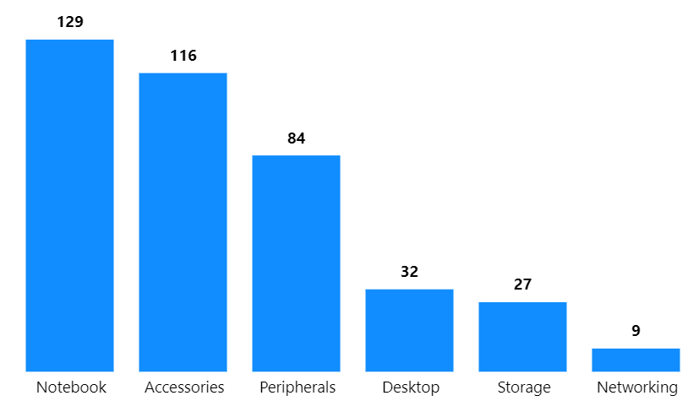
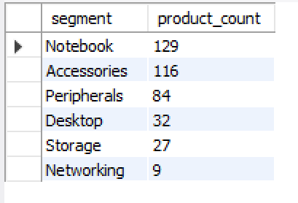
Request 3 : Provide a report with all the unique product counts for each segment and sort them in descending order of product counts. The final output contains 2 fields :
segment, product_count

Slide 6
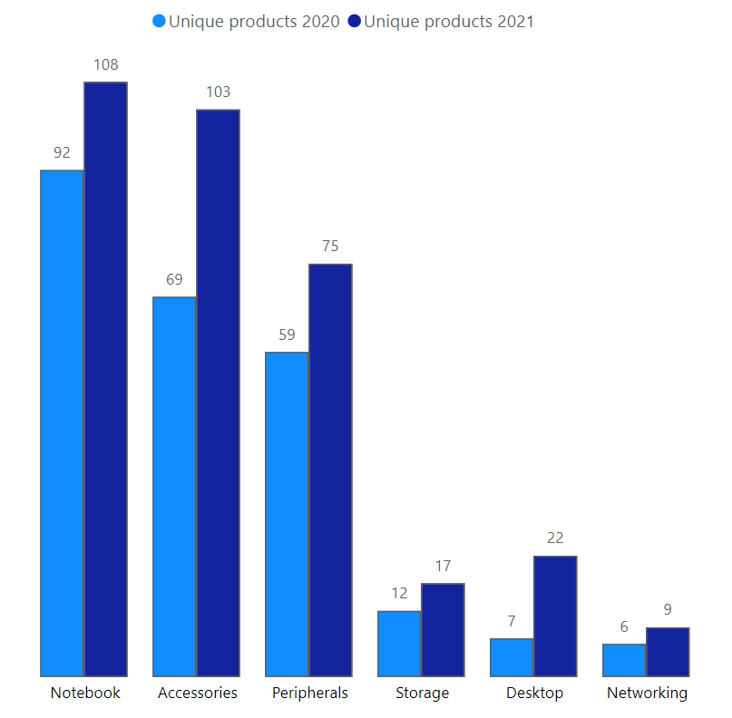
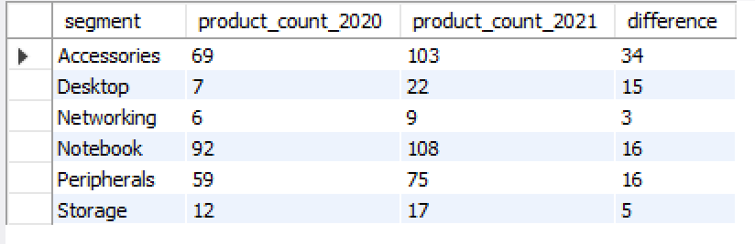
Request 4 : Which segment had the most increase in unique products in 2021 vs 2020? The final output contains these fields :
segment, product_count_2020, product_count_2021, difference.

Slide 7
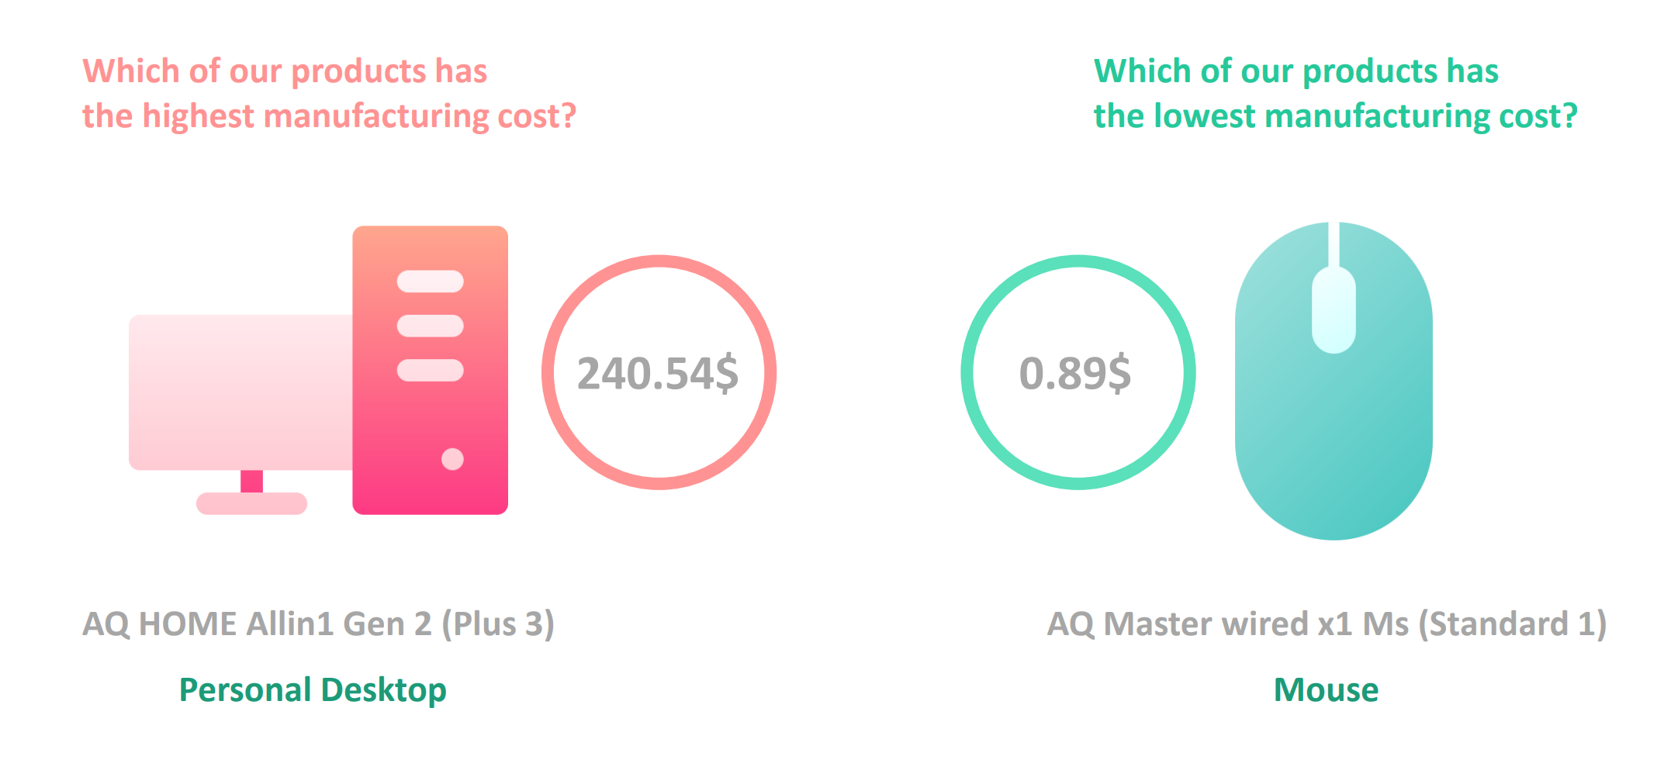
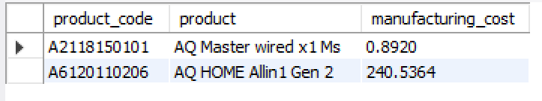
Request 5 : Get the products that have the highest and lowest manufacturing costs. The final output should contain these fields :
product_code, product manufacturing_cost

Slide 8
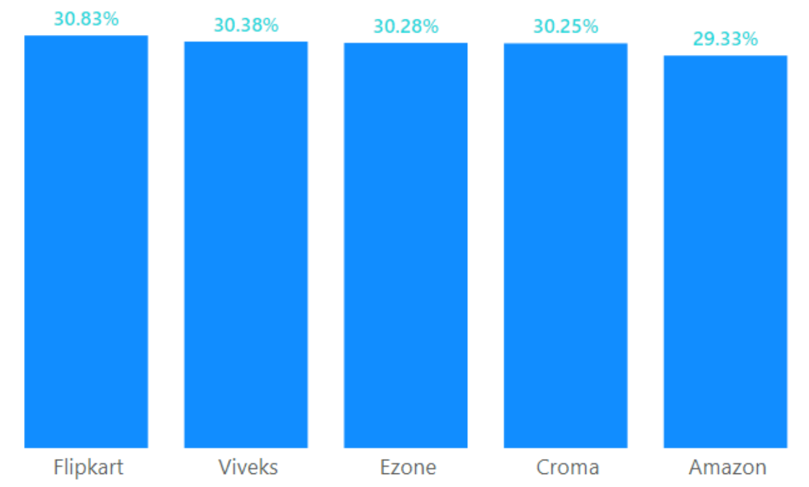
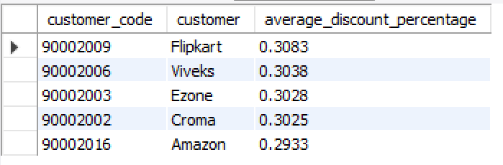
Request 6 : Generate a report which contains the top 5 customers who received an average high pre_invoice_discount_pct for the fiscal year 2021 and in the Indian market. The final output contains these fields :
customer_code, customer, average_discount_percentage

Slide 9
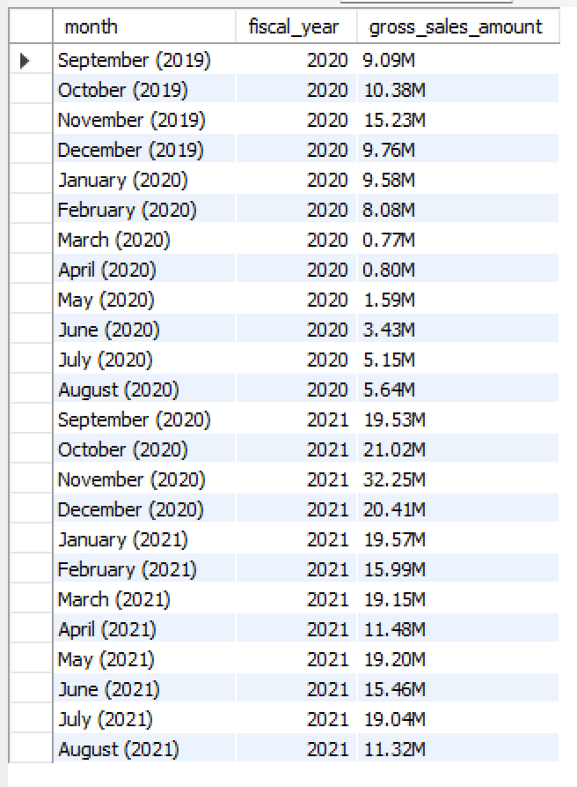
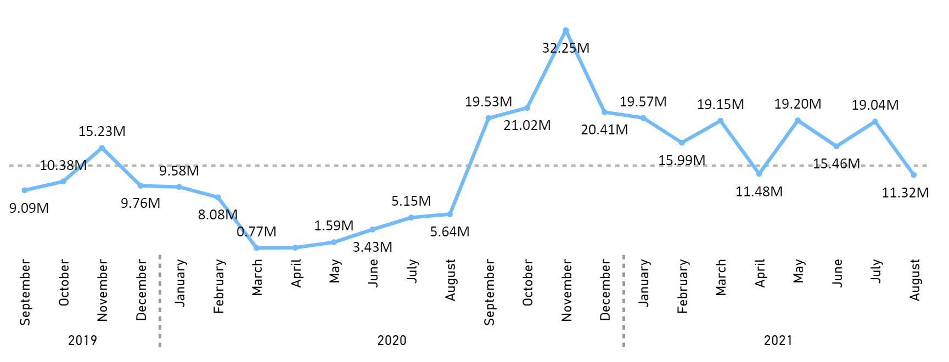
Request 7 : Get the complete report of the Gross sales amount for the customer “Atliq Exclusive” for each month . This analysis helps to get an idea of low and high- performing months and take strategic decisions. The final report contains these columns :
Month, Year, Gross sales Amount

Slide 10
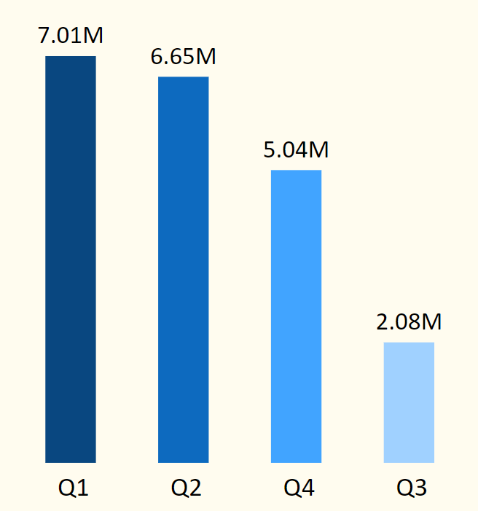
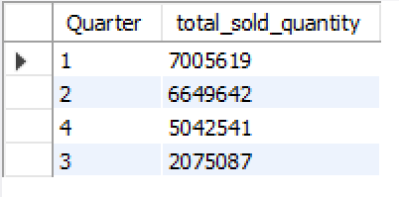
Request 8 : In which quarter of 2020, got the maximum total_sold_quantity? The final output contains these fields sorted by the total_sold_quantity :
Quarter, total_sold_quantity

Slide 11
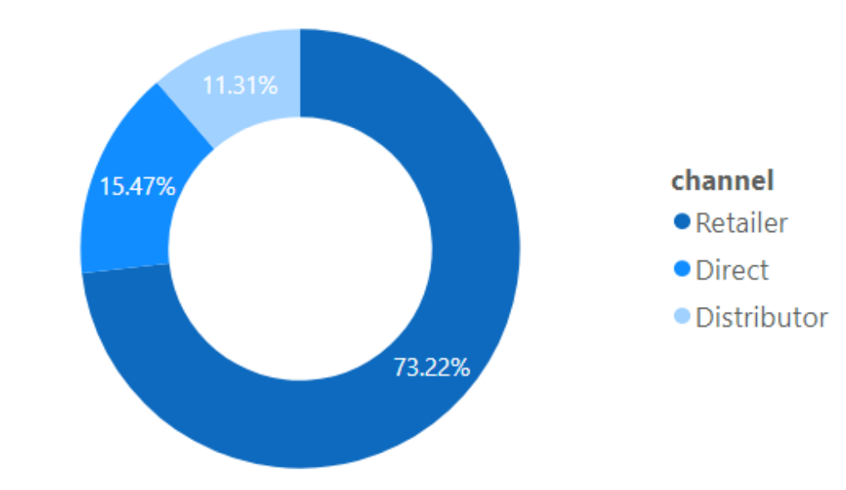
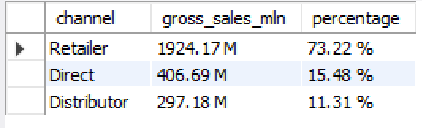
Request 9 : Which channel helped to bring more gross sales in the fiscal year 2021 and the percentage of contribution? The final output contains these fields :
channel, gross_sales_mln, percentage

Slide 12
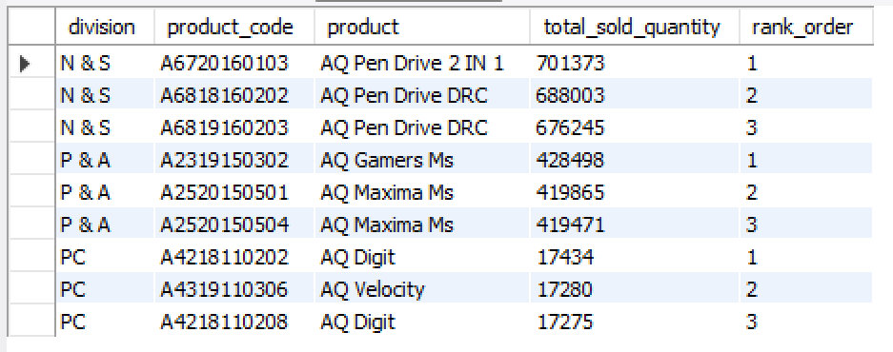
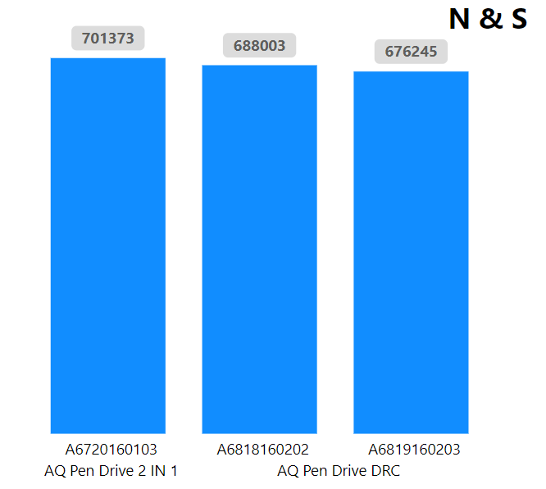
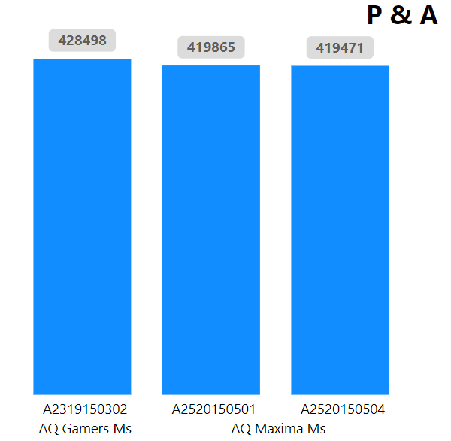
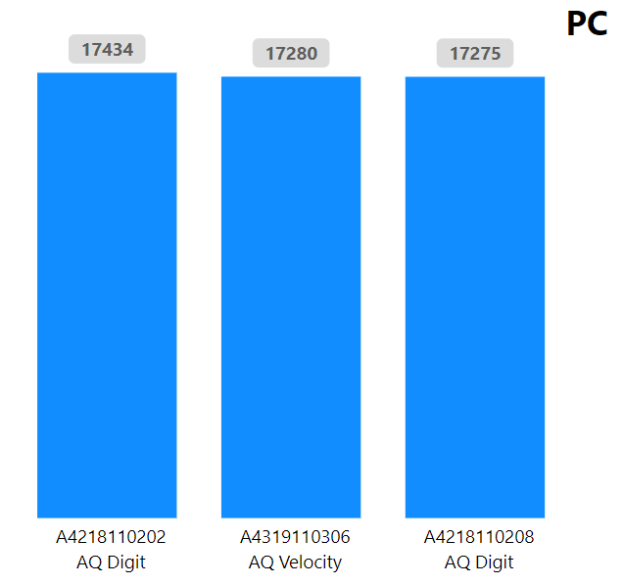
Request 10 : Get the Top 3 products in each division that have a high total_sold_quantity in the fiscal_year 2021? The final output contains these fields :
division, product_code, product, total_sold_quantity, rank_order

Slide 13
END
THANK YOU !

